Slide 1
Guided Capstone

Slide 2
Problem Identification
We are looking for ways to find a better market ticket price for Big Mountain resort based on the facilities it provides along with its location? We need to find a solution that allows for ticket sales to remain the same or increase in revenue?
How can we optimize the facilities that Big Mountain resort has to offer so that an increase in ticket prices will be offset by the amenities provided?
What should we base the ticket prices on? Would it primarily be geographical region, features or a combination of both?

Slide 3
Recommendation and key findings
We recommend adding a run, increasing the vertical drop by at least 150 ft, and installing additional chair lifts. This would support an increase in ticket prices, and overall revenue.
Big Mountain resort has the highest ticket price in Montana, although it has a number of features that support this high-ticket price including vertical drop, highest snow-making area, highest total number of chairs, highest fast quads, a large number of runs among other features. This makes the overall value of this resort quite high and will support an increase in ticket price. Although the geographic region is not among the most frequented or populous, the value of Big Mountain resort makes the travel to the location worth the trip.

Slide 4
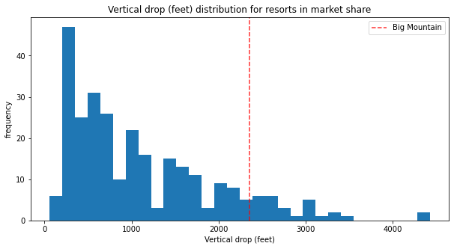
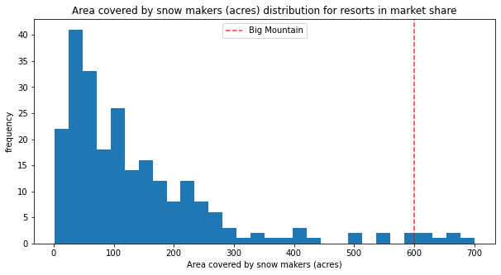
Modeling results and analysis

Slide 5
Modeling results and analysis
Big Mountain resort has high vertical drop around 2400 feet, it has a very high snow making area of around 600 feet, fourteen total chairs. These features all make Big Mountain resort a high in-demand resort to travel to, and if these features can be optimized, such as increasing the total number of chairs then it would support a higher ticket price without a decrease in revenue.

Slide 6
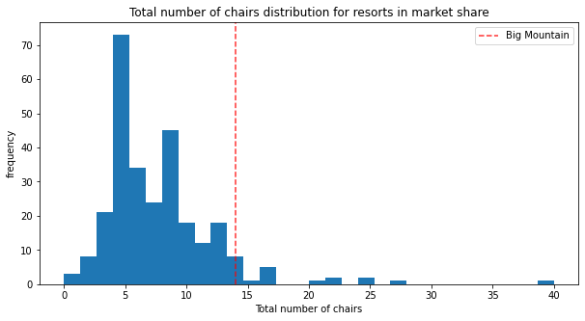
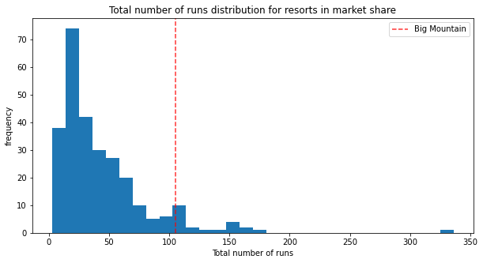
Modeling results and analysis

Slide 7
Summary and conclusion
Big Mountain Resort has many amenities that support a higher ticket price. It has features that will offset the increase in ticket price. The features that will need to be improved include the vertical drop, snow making area, total chairs, and total number of runs. The vertical drop should be increased by at least 150 feet, the snow making area should be increased by 4 acres, one additional chair should be installed, and the longest run should be increased by a quarter mile.

